Slide 1
Conditional Modeling For Fun and Profit
Kyle Kastner
Université de Montréal - MILA
Intern - IBM Watson @ Yorktown Heights

Slide 2
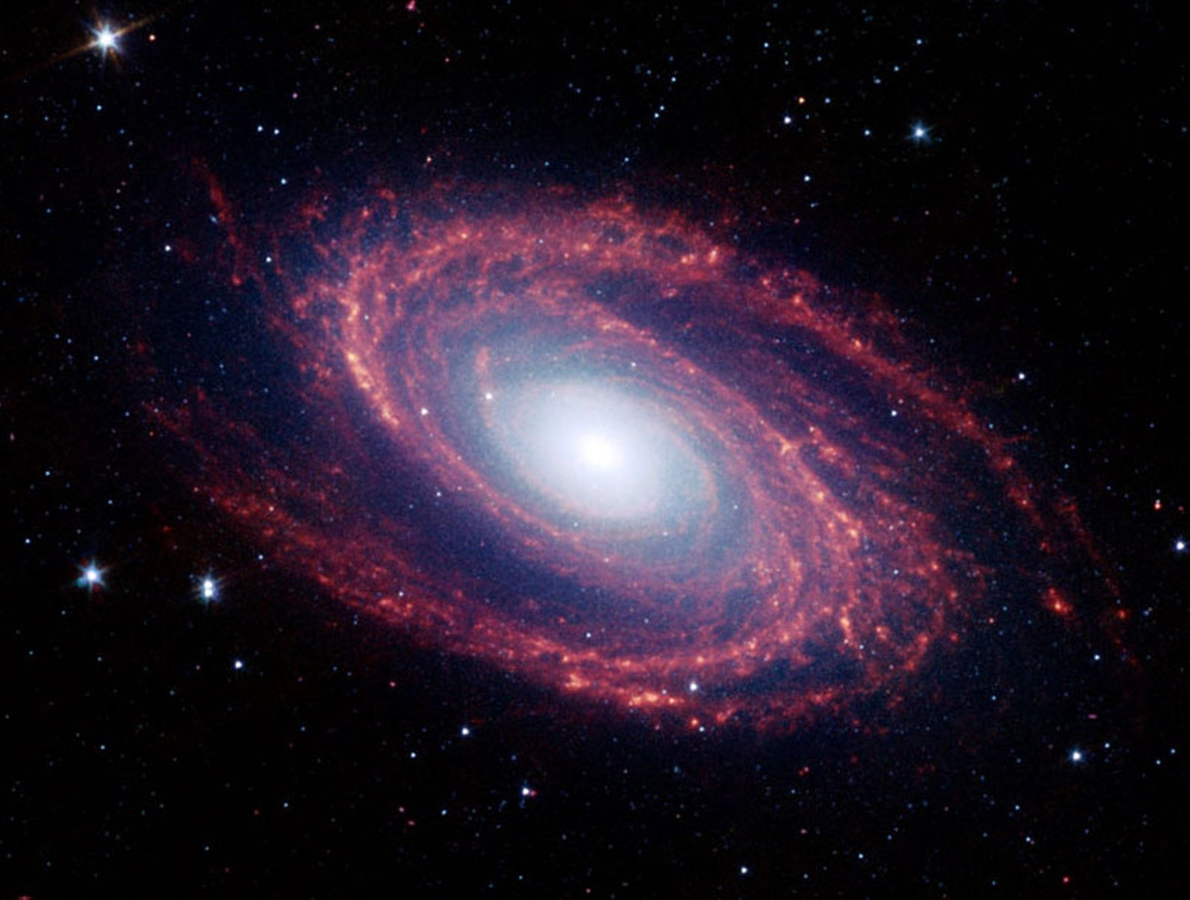
Deep Learning, Simple Concepts
Universal function approximators
Learn the features
Desire hierarchy in learned features
y = h(g(f(x))
{h, g, f} are nonlinear functions
Classification
Learn p(y | x) = h(g(f(x))
[1]

Slide 3
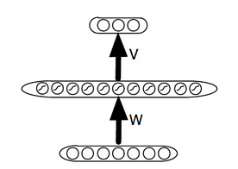
Basic Anatomy
Weights (W, V)
Biases (b, c)
Morph features using non-linear functions e.g.
layer_1_out = tanh(dot(X, W) + b)
layer_2_out = tanh(dot(layer_1_out, V) + c) ...
Backpropagation to “step” values of W,V,b,c
[1, 2][]

Slide 4
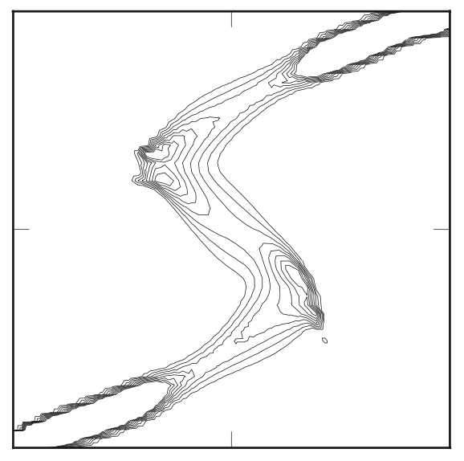
Mixture Density Networks
What are sufficient statistics?
Describe an instance of a distribution
Gaussian with mean u, variance s
Bernoulli with probability p
Ties to neural networks
Arbitrary output parameters
Can we interpret parameters in a layer as sufficient statistics? YES!
Cost / regularization forces this relationship
[3, 1]

Slide 5
Parameterizing Distributions
sigmoid -> Bernoulli
softmax -> Multinomial
linear, linear -> Gaussian with mean, log_var
softmax, linear, linear -> Gaussian mixture
Can combine with recurrence
Learned, dynamic distributions over sequences
Incredibly powerful
[3, 1, 4, 5, 6, 7, 8, 9]

Slide 6
Visually...
mean
log variance
[1, 10]

Slide 7
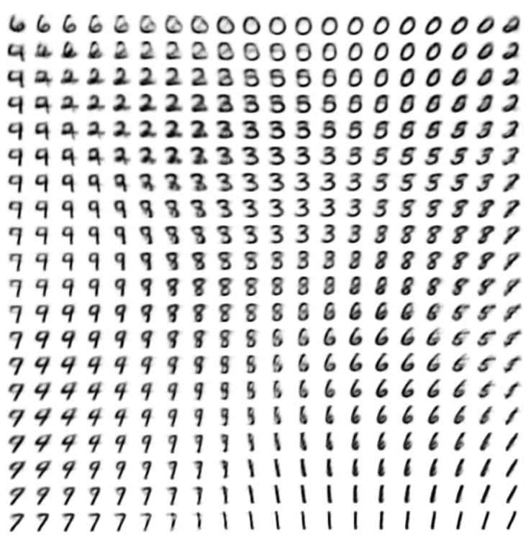
Latent Factor Generative Models
Auto-Encoding Variational Bayes D. Kingma and M. Welling
Model known as Variational Autoencoder (VAE)
See also Stochastic Backpropagation and Approximate Inference in Deep Generative Models, Rezende, Mohamed, Wierstra
[11, 12, 13]

Slide 8
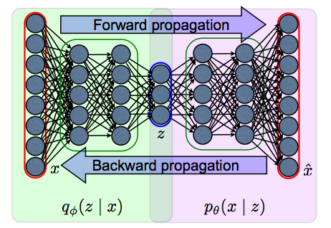
ENCODER
DECODER
[11, 12, 13]

Slide 9
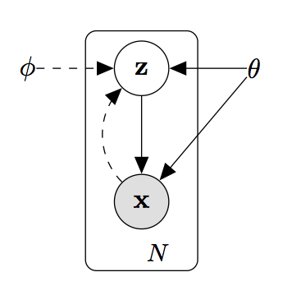
A Bit About VAE
Want to do latent variable modeling
Don’t want to do MCMC or EM
Sampling Z blocks gradient
Reparameterization trick
Exact soln intractable for complex transforms (like NN)
Lower bound on likelihood with KL divergence
N(mu, sigma) -> mu + sigma * N(0, 1)
Like mixture density networks, but in the middle
Now trainable by backprop
[11, 12, 13]

Slide 10
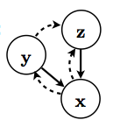
Taking The Wheel
Specifics of MNIST digits
Writing style and class
Traits are semi-independent
Can encode this in the model
y -> softmax classifier (~y is sample)
p(z | x, y), p(z | x, ~y) or p(z | x, f(x))
Fully conditional version of M2
Semi-Supervised Learning with Deep Generative Models, Kingma, Rezende, Mohamed, Welling
[13, 14]

Slide 11

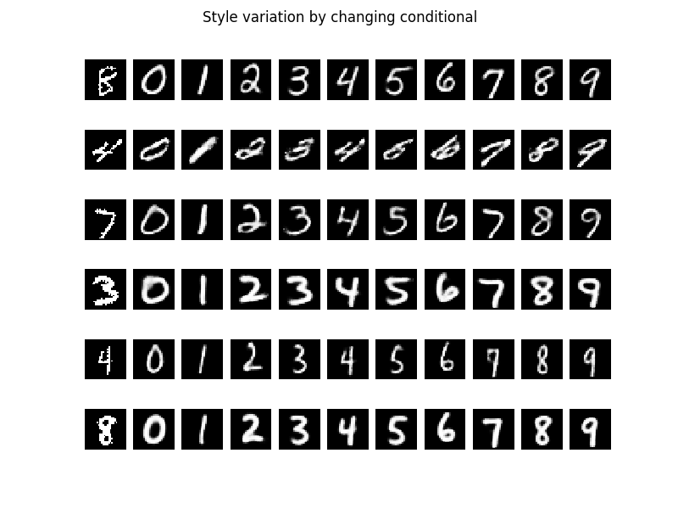
Conditioning, Visually
[13, 14]

Slide 12

In Practice...
Conditioning is a strong signal
p(x_hat | z) vs. p(x_hat | z, y)
Can give control or add prior knowledge
Classification is an even stronger form
Prediction is learned by maximizing p(y | x) !
In classification, don’t worry about forming a useful z
[1, 13, 14]

Slide 13

Conditioning Feedforward
Concatenate features
concatenate((X_train, conditioning), axis=1)
p(y | X_1 … X_n, L_1 … L_n)
One hot label L (scikit-learn label_binarize)
Could also be real valued
Concat followed with multiple layers to “mix”
[1]

Slide 14
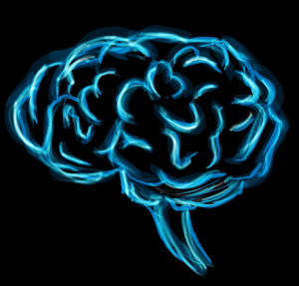
Convolution and Recurrence
Exploit structure and prior knowledge
Parameter sharing is strong regularization
Convolution - exploit locality
p(y | X_{i - n} … X_{i + n}) * p(y | X_{i + 1 - n} ... X_{i +1 + n})...
A learned filter over a fixed 1D or 2D window
Window slides over all input, updates filter
Recurrence - exploit sequential information
p(y | X_1 … X_t) = p(y | X_<=t) can be seen as:
~ p(y | X_1) * p(y | X_2, X_1) * p(y | X_3, X_2, X_1) ...
[1, 4, 5, 6, 7, 8, 9]

Slide 15
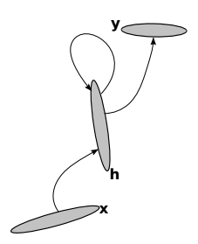
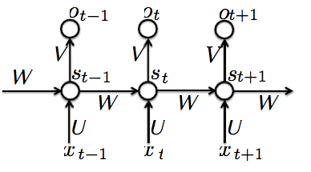
More on Recurrence
Hidden state (s_t) encodes sequence info
p(X_<=t) (in s_t) is compressed representation of X
Recurrence similar to
Hidden Markov Model (HMM)
Kalman Filter (KF, EKF, UKF)
[1, 4, 15, 16]

Slide 16
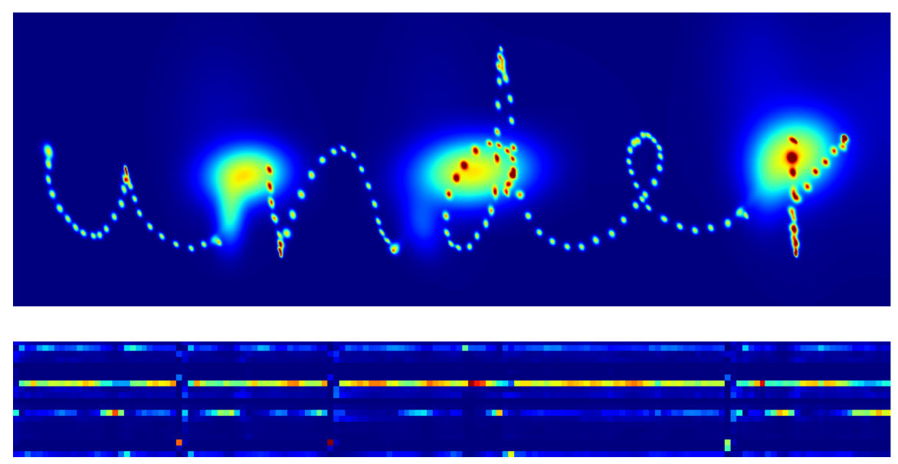
How-To MDN + RNN
Generating Sequences with Recurrent Neural Networks Alex Graves
http://arxiv.org/abs/1308.0850
Multi-level RNN, outputs GMM and bernoulli
Handwriting
Pen up/down and relative position per timestep
Vocoder representation of speech
Voiced/unvoiced and MFCC per timestep
[3, 4]

Slide 17
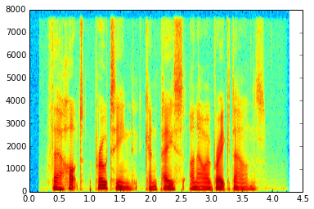

How-To Continued
Conditional model
Adds input attention (more on this later)
Gaussian per timestep over one hot text
p(bernoulli, GMM | X_t, previous state, focused text)
This gives control of the output via input text
http://www.cs.toronto.edu/~graves/handwriting.html
https://www.youtube.com/watch?v=-yX1SYeDHbg&t=43m30s
[3, 4]

Slide 18
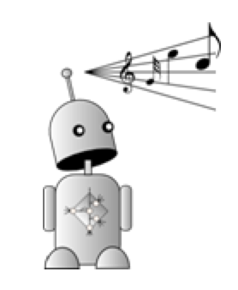
Similar Approaches
RNN with sigmoid output
ALICE
RNN with softmax
RNN-LM
RNN-RBM, RNN-NADE
[3, 1, 4, 5, 6, 7, 8, 9]

Slide 19
Research Questions
?
?
?
Possible Issues
Prosody/style are not smooth over time
Deep network, but still shallow latent variables
Vocoder is a highly engineered representation
How can we fix these problems?
First, a bit about conditioning in RNNs
?
?
?

Slide 20
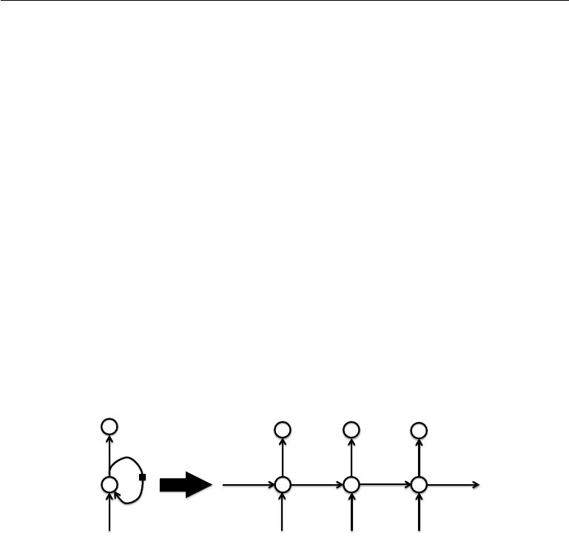
Conditioning In Recurrent Networks
RNNs model p(X_t | X_<t)
Initial hidden state can condition
p(X_t | X_<t, c) where c is init. hidden state (context)
Condition by concatenating in feedforward
Before recurrence or after
Can do all of the above
[1, 4, 15, 16, 17]

Slide 21
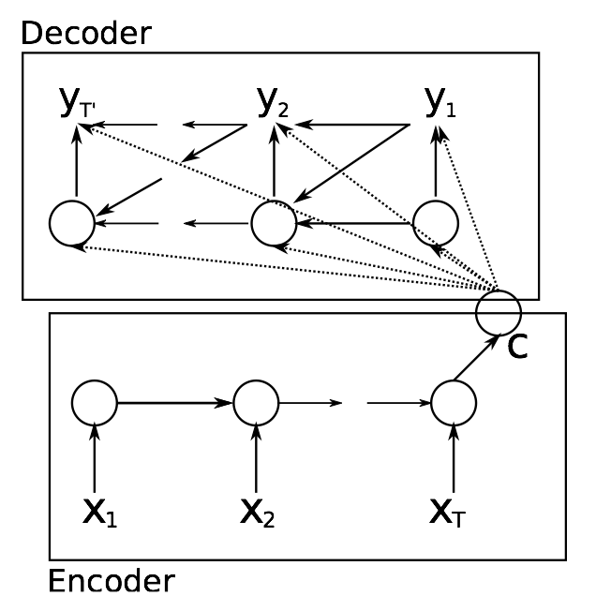
Conditioning with a Sequence
RNN outputting Gaussian parameters over seq
Seen in Generating Sequences
Use an RNN to compress
Hidden state encodes p(X_<=t)
Project into init hidden and ff
Now have p(y_t | y_<t, X_<=t)
Known as RNN Encode-Decode
Cho et al
[16, 17]

Slide 22
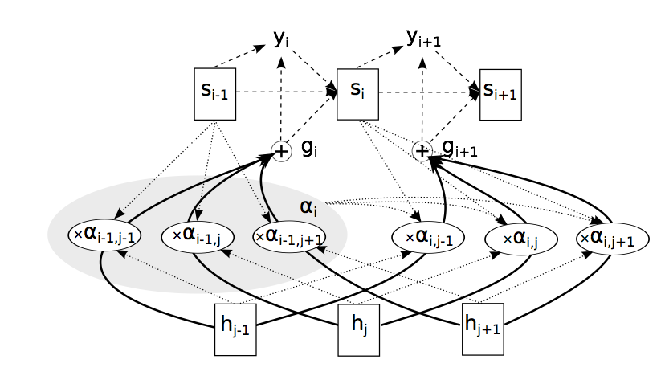
Distributing The Representation
Distribute context, Bahdanau et al
Bidirectional RNN
p(X_i | X_<i, X_>i) for i in t
Needs whole sequence
But sometimes this is fine
Soft attention over hiddens
Choose what is important
[16, 17, 18]

Slide 23
Previously, on FOX...
RNN-GMM Issues
Prosody/style are not smooth over time
Deep network, but still shallow latent variables
Vocoder is a highly engineered representation
How can we try to fix these problems?
Distributed latent representation for Z
Use modified VAE to make latents deep
Work on raw timeseries inputs
Extreme approach, but proves a point

Slide 24
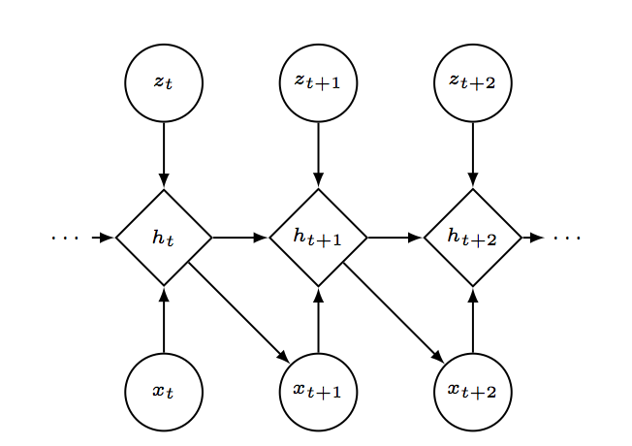
Existing Approaches
VRAE, Z_t independent
STORN, Z_t independent
DRAW, Z_t loosely dependent via canvas
No large scale real-valued experiments
VRAE, no real valued experiment
STORN, real valued experiment was small
DRAW, real values weren’t sequences
[18, 19, 20]

Slide 25
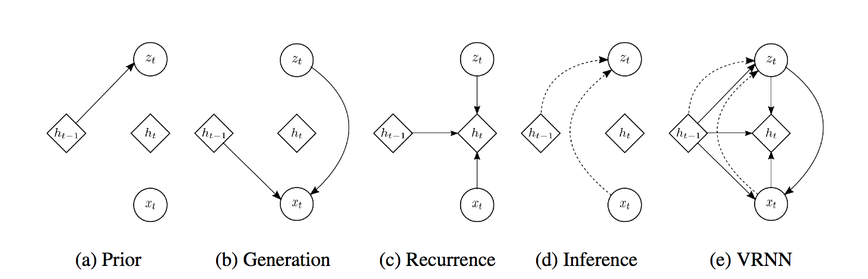
Variational RNN
Speech
Complex but structured noise driven by mechanics
Ideal latent factors include these mechanics
Z_<t should affect Z_t and h_t
Use a recurrent prior
[15]

Slide 26
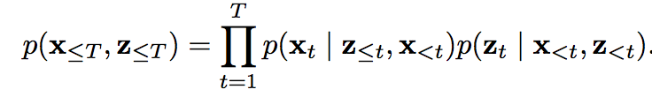
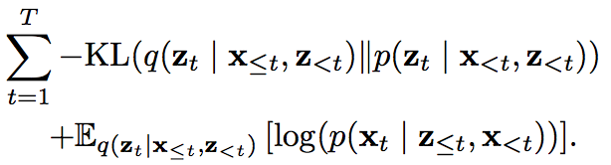

Primary Functions
[15]

Slide 27
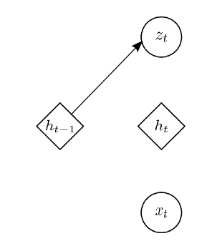
Prior
Used for KL divergence
Fixed in VAE to N(0, 1)
Here it is learned
Instead of “be simple” (as in VAE), this says “be consistent”
[15]

Slide 28
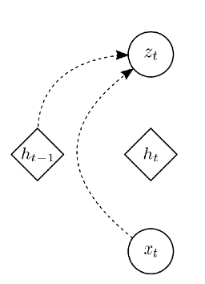
Inference (encode)
Previous hidden state
h_t-1
Data
X_t
Hidden state information
z_<t
X_<t
[15]

Slide 29
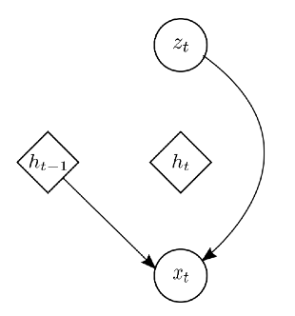
Generation (decode)
Generate based on
Z_t, h_t-1
h_t-1 has z_<t, X_<t
Z_t has z_<t, X_<=t
[15]

Slide 30
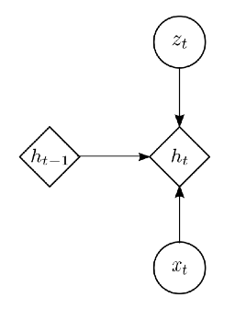
Recurrence
Just a regular RNN
Input projection is a VAE
Can use LSTM, GRU, others
[15]

Slide 31
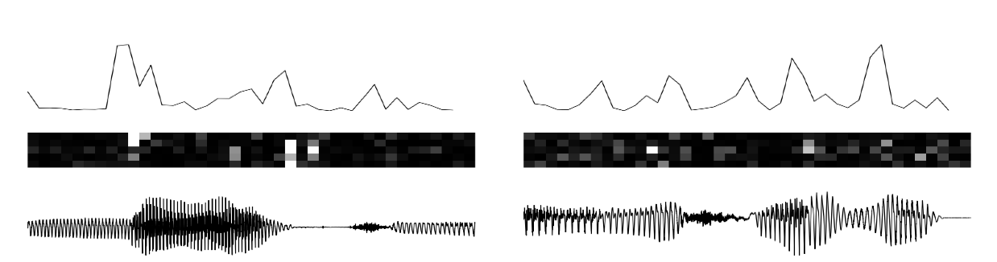
KL Divergence
[15]

Slide 32
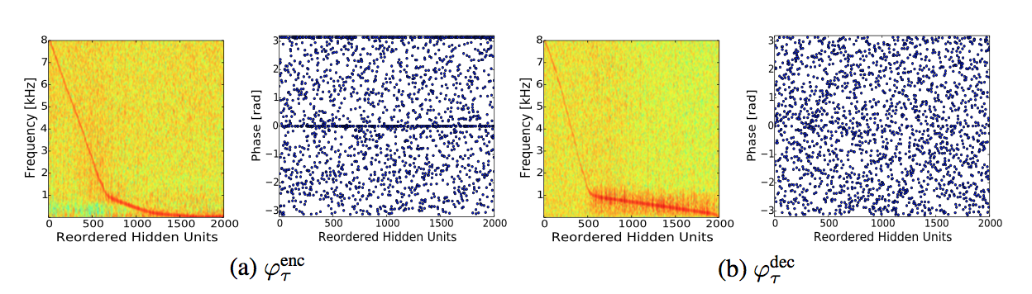
Learned Filters
[15]

Slide 33
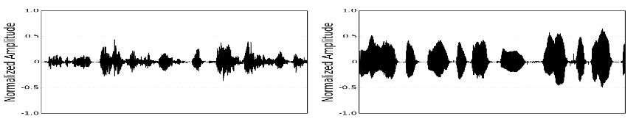
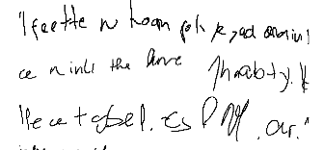
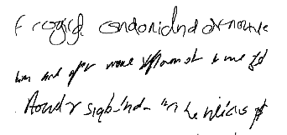
Final Thoughts on VRNN
Empirically, structured Z seems to help
Keep style consistent
Predict very correlated data, like raw timeseries
Also works well for unconditional handwriting
RNN-GMM
VRNN-GMM
[4, 15]

Slide 34
Takeaways and Opinions
Can use deep learning like graphical modeling
Different tools, same conceptual idea
Conditional probability modeling is key
Put knowledge in model structure, not features
Let features be learned from data
Use conditioning to control or constrain

Slide 35


Thanks!
@kastnerkyle
Slides will be uploaded to https://speakerdeck.com/kastnerkyle

Slide 36
References (1)
[1] Y. Bengio, I. Goodfellow, A. Courville. “Deep Learning”, in preparation for MIT Press, 2015. http://www.iro.umontreal.ca/~bengioy/dlbook/
[2] D. Rumelhart, G. Hinton, R. Williams. "Learning representations by back-propagating errors", Nature 323 (6088): 533–536, 1986. http://www.iro.umontreal.ca/~vincentp/ift3395/lectures/backprop_old.pdf
[3] C. Bishop. “Mixture Density Networks”, 1994. http://research.microsoft.com/en-us/um/people/cmbishop/downloads/Bishop-NCRG-94-004.ps
[4] A. Graves. “Generating Sequences With Recurrent Neural Networks”, 2013. http://arxiv.org/abs/1308.0850
[5] D. Eck, J. Schmidhuber. “Finding Temporal Structure In Music: Blues Improvisation with LSTM Recurrent Networks”. Neural Networks for Signal Processing, 2002. ftp://ftp.idsia.ch/pub/juergen/2002_ieee.pdf
[6] A. Brandmaier. “ALICE: An LSTM Inspired Composition Experiment”. 2008.
[7] T. Mikolov, M. Karafiat, L. Burget, J. Cernocky, S. Khudanpur. “Recurrent Neural Network Based Language Model”. Interspeech 2010. http://www.fit.vutbr.cz/research/groups/speech/publi/2010/mikolov_interspeech2010_IS100722.pdf
[9] N. Boulanger-Lewandowski, Y. Bengio, P. Vincent. “Modeling Temporal Dependencies in High-Dimensional Sequences: Application To Polyphonic Music Generation and Transcription”. ICML 2012. http://www-etud.iro.umontreal.ca/~boulanni/icml2012
[10] Y. LeCun, L. Bottou, Y. Bengio, and P. Haffner. "Gradient-based learning applied to document recognition." Proceedings of the IEEE, 86(11):2278-2324, 1998. http://yann.lecun.com/exdb/mnist/
[11] D. Kingma, M. Welling. “Auto-encoding Variational Bayes”. ICLR 2014. http://arxiv.org/abs/1312.6114
[12] D. Rezende, S. Mohamed, D. Wierstra. “Stochastic Backpropagation and Approximate Inference in Deep Generative Models”. ICML 2014. http://arxiv.org/abs/1401.4082

Slide 37
References (2)
[13] A. Courville. “Course notes for Variational Autoencoders”. IFT6266H15. https://ift6266h15.files.wordpress.com/2015/04/20_vae.pdf
[14] D. Kingma, D. Rezende, s. Mohamed, M. Welling. “Semi-supervised Learning With Deep Generative Models”. NIPS 2014. http://arxiv.org/abs/1406.5298
[15] J. Chung, K. Kastner, L. Dinh, K. Goel, A. Courville, Y. Bengio. “A Stochastic Latent Variable Model for Sequential Data”. http://arxiv.org/abs/1506.02216
[16] K. Cho, B. Merrienboer, C. Gulchere, D. Bahdanau, F. Bougares, H. Schwenk, Y. Bengio. “Learning Phrase Representations using RNN Encoder-Decoder for Statistical Machine Translation”. EMNLP 2014. http://arxiv.org/abs/1406.1078
[17] D. Bahdanau, K. Cho, Y. Bengio. “Neural Machine Translation By Jointly Learning To Align and Translate”. ICLR 2015. http://arxiv.org/abs/1409.0473
[18] K. Gregor, I. Danihelka, A. Graves, D. Rezende, D. Wierstra. “DRAW: Directed Recurrent Attention Writer”. http://arxiv.org/abs/1502.04623
[19] J. Bayer, C. Osendorfer. “Learning Stochastic Recurrent Networks”. http://arxiv.org/abs/1411.7610
[20] O. Fabius, J. van Amersmoot. “Variational Recurrent Auto-Encoders”. http://arxiv.org/abs/1412.6581

Slide 38

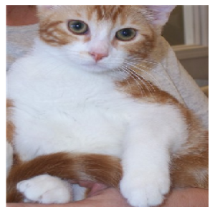
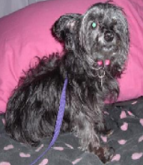
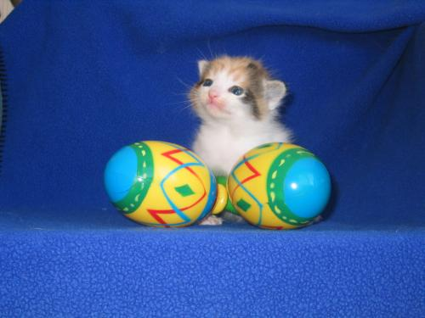
More on Convolution
Define size of feature map and how many
Similar to output size of feedforward layer
Parameter sharing
Small filter moves over entire input
Believe local statistics consistent over regions
Enforced by parameter sharing
Condition by concatenating
Along “channel” axis
http://arxiv.org/abs/1406.2283

